Slide 1
Christmas
2 Timothy 3:16-17
¹⁶ All Scripture is God-breathed and is useful for teaching, rebuking, correcting and training in righteousness, ¹⁷ so that the servant of God may be thoroughly equipped for every good work.

Slide 2
Christmas
The Root behind the Fruit

Slide 3
OVERVIEW PLAN
History
Root Behind the Fruit
Truth to be presented
Santa………
What do I do now?

Slide 4
This PowerPoint
Truth has led me to a decision….because of traditions, this has been challenging… but ask yourself….”Do I want the truth or want to keep my traditions”…
You may be faced with the same challenge.. Therefore what I am presenting is what I believe is the truth.. This will lead you to some decision
Romans 12:18 If it is possible, as far as it depends on you, live at peace with everyone.

Slide 5
Why do we take Communion? ROOT behind the FRUIT
Matthew 26:26-28 Now as they were eating, Jesus took bread, and after blessing it broke it and gave it to the disciples, and said, “Take, eat; this is my body.” And he took a cup, and when he had given thanks he gave it to them, saying, “Drink of it, all of you, for this is my blood of the covenant, which is poured out for many for the forgiveness of sins.
Luke 22:19-20 And he took bread, and when he had given thanks, he broke it and gave it to them, saying, “This is my body, which is given for you. Do this in remembrance of me.” And likewise the cup after they had eaten, saying, “This cup that is poured out for you is the new covenant in my blood.

Slide 6
POP QUIZ
When was Christmas recognized as a holiday in America?
1870 - President Ulysses Grant made Christmas a federal holiday.
Christmas origin……
Some have said Christ and mas meaning more in Spanish.. More of Christ!
Keep CHRIST in Christmas….
CHRIST mass – sacrifice of Christ – what is done at mass…. Not the same has taking communion
The Mass contains the four essential elements of a true sacrifice: priest, victim, altar, and sacrifice. Its Priest, Jesus Christ, uses the ministry of an earthly representative; its Victim, Jesus Christ, truly present under the appearances of bread and wine; its altar; and the Sacrifice is a mystic representation of the blood-shedding of Calvary. Thus, the Mass is offered for four ends: adoration, atonement, thanksgiving, and petition

Slide 7
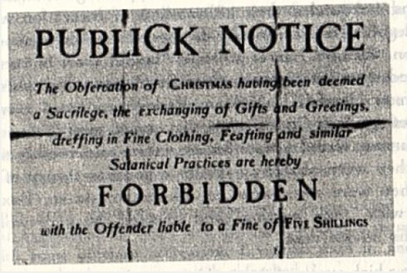
The year is 1670……in boston

Slide 8
The year is 1670……in boston
Shocking as it sounds, followers of Jesus Christ in both America and England helped pass laws making it illegal to observe Christmas, believing it was an insult to God to honor a day associated with ancient paganism
Illegal from 1659 to 1681
Christmas trees and decorations were considered to be unholy pagan rituals, and the Puritans also banned traditional Christmas foods such as mince pies and pudding. Puritan laws required that stores and businesses remain open all day on Christmas, and town criers walked through the streets on Christmas Eve calling out "No Christmas, no Christmas!“

Slide 9
The year is 1670……in boston
However, the Puritan presence remained in New England and Christmas did not become a legal holiday there until 1856. Even then, some schools continued to hold classes on December 25 until 1870.
Although the change was gradual, people began to once again embrace the holiday until Christmas as we know it today complete with mistletoe, eggnog and candy canes was celebrated throughout the American colonies.

Slide 10
Why was it illegal at one time? Celebration of saturnalia
Saturnalia – the most popular holiday on the ancient Rome calendar, derived from older farming-related rituals of midwinter and the winter solstice especially the practice of offering gifts or sacrifices to the gods during the winter sowing season
During Saturnalia, work and businesses came to a halt. Schools and courts closed and the normal social patterns were suspended.

Slide 11
Celebration of saturnalia (cont.)
People decorated their homes with wreaths and other greenery, and shed their traditional togas in favor of colorful clothes known as synthesis. Even slaves did not have to work during Saturnalia, but were allowed to participate in the festivities; in some cases, they sat at the head of the table while their masters served them.

Slide 12
Connection between saturnalia and Christmas
The Christian holiday of Christmas, especially, owes many of its traditions to the ancient Roman festival, including the time of year Christmas is celebrated.
But by the fourth century A.D., Western Christian churches settled on celebrating Christmas on December 25, which allowed them to incorporate the holiday with Saturnalia and other popular pagan midwinter traditions.
Pagans and Christians co-existed (not always happily) during this period, and this likely represented an effort to convince the remaining pagan Romans to accept Christianity as Rome’s official religion.
Before the end of the fourth century, many of the traditions of Saturnalia—including giving gifts, singing, lighting candles, feasting and merrymaking—had become absorbed by the traditions of Christmas as many of us know them today.

Slide 13
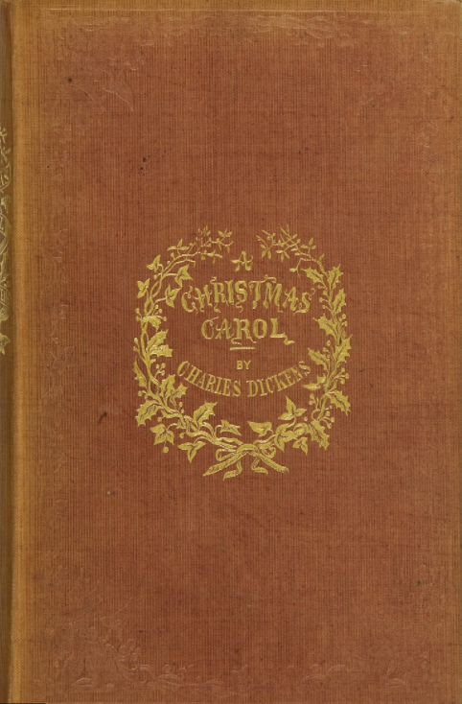
So what happened prior to 1870 leading to change in AMERICA?
December 19, 1843 – Charles Dickens published “A Christmas Carol”
People read this and thought – this is really neat!

Slide 14
Some more History…

Slide 15
Pagan celebrations
The middle of winter has long been a time of celebration around the world. Centuries before the arrival of the man called Jesus, early Europeans celebrated light and birth in the darkest days of winter. Many peoples rejoiced during the winter solstice, when the worst of the winter was behind them and they could look forward to longer days and extended hours of sunlight.

Slide 16
Scandinavian
In Scandinavia, the Norse celebrated Yule from December 21, the winter solstice, through January. In recognition of the return of the sun, fathers and sons would bring home large logs, which they would set on fire. The people would feast until the log burned out, which could take as many as 12 days. The Norse believed that each spark from the fire represented a new pig or calf that would be born during the coming year.

Slide 17
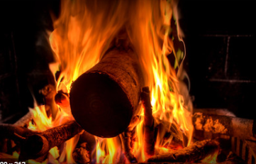
Yule log
As long as the yule log burned, feasting and revelry reigned supreme (almost 12 days)
Partied inside and believed that outside there were demons and spirits
YULE
Troll the ancient yule tide carol Fa la la la la, la la la la Everybody sing, the yule tide carol Fa la la, la la

Slide 18
Germany
In Germany, people honored the pagan god Oden during the mid-winter holiday. Germans were terrified of Oden, as they believed he made nocturnal flights through the sky to observe his people, and then decide who would prosper or perish. Because of his presence, many people chose to stay inside.

Slide 19
Rome
Also around the time of the winter solstice, Romans observed Juvenalia, a feast honoring the children of Rome. In addition, members of the upper classes often celebrated the birthday of Mithra, the god of the unconquerable sun, on December 25. It was believed that Mithra, an infant god, was born of a rock. For some Romans, Mithra’s birthday was the most sacred day of the year.

Slide 20
Rome
In Rome, where winters were not as harsh as those in the far north, Saturnalia—a holiday in honor of Saturn, the god of agriculture—was celebrated. Beginning in the week leading up to the winter solstice and continuing for a full month, Saturnalia was a hedonistic time, when food and drink were plentiful and the normal Roman social order was turned upside down. For a month, slaves would become masters. Peasants were in command of the city. Business and schools were closed so that everyone could join in the fun.

Slide 21
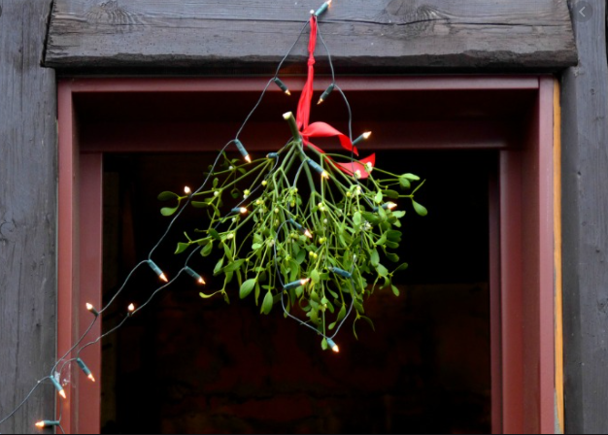
mistletoe
Comes from the Druids – it is supposed to posses mystical powers which bring luck to the household and wards off evil spirits
Some would put it over their door posts to protect their homes – mistletoe
Deuteronomy 6:7-9 – WRITE it over your door posts…doors are a way in..protect the entrance. Our faith is in the scripture.. Their faith are in idols..other gods

Slide 22
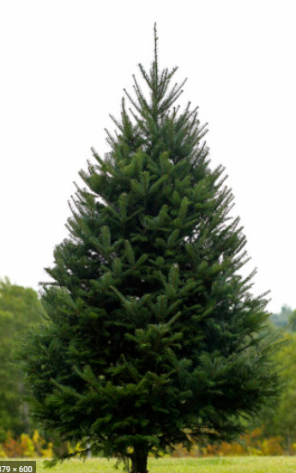
The fir tree

Slide 23
Christmas tree history
St. Boniface was a monk who used the triangular shape of the fir tree to describe the Holy Trinity of God (Father, Son, and Holy Spirit)
The first decorated tree was at Riga in Latvia in 1510, while the first Christmas tree came to England with the Georgian Kings from Germany
In 1536, Martin Luther was the first to bring the tree inside the home. The story goes that Luther was walking through a pine forest near his home in Wittenberg when he suddenly looked up and saw thousands of stars glinting jewel-like among the branches. This wonderous sight inspired him to set up a candle-lit fir tree in his house at Christmas to remind his children of the starry heavens from whence their Savior came.

Slide 24
The “fir tree” and its significance
The ancient Egyptians worshipped a god called Ra, who had the head of a hawk and wore the sun as a blazing disk in his crown. At the solstice, when Ra began to recover from his illness, the Egyptians filled their homes with green palm rushes, which symbolized for them the triumph of life over death.
In the Northern hemisphere, the shortest day and longest night of the year falls on December 21 or December 22 and is called the winter solstice. Many ancient people believed that the sun was a god and that winter came every year because the sun god had become sick and weak. They celebrated the solstice because it meant that at last the sun god would begin to get well. Evergreen boughs reminded them of all the green plants that would grow again when the sun god was strong and summer would return.

Slide 25
The “fir tree” and its significance
Long before the advent of Christianity, plants and trees that remained green all year had a special meaning for people in the winter. Just as people today decorate their homes during the festive season with pine, spruce, and fir trees, ancient peoples hung evergreen boughs over their doors and windows. In many countries it was believed that evergreens would keep away witches, ghosts, evil spirits, and illness.
Deuteronomy 6:7-9 ⁷ Impress them on your children. Talk about them when you sit at home and when you walk along the road, when you lie down and when you get up. ⁸ Tie them as symbols on your hands and bind them on your foreheads. ⁹ Write them on the doorframes of your houses and on your gates.

Slide 26
Jeremiah 10:2-4
² This is what the Lord says:
“Do not learn the ways of the nations or be terrified by signs in the heavens, though the nations are terrified by them. ³ For the practices of the peoples are worthless; they cut a tree out of the forest, and a craftsman shapes it with his chisel. ⁴ They adorn it with silver and gold; they fasten it with hammer and nails so it will not totter.

Slide 27
Scripture
Nimrod – Genesis 10:8-12 – one of the first mighty man post flood
Supposedly led the people to reject God again after the flood.
Genesis 10:10…The beginning of his kingdom was Babel >> Babylon
Babylon - Pagan Idol Worship – Reject God and worship idols or other false gods, led by Nimrod (Nimrod means – “rebel” in Hebrew)
Babylon Evil – Revelation 18:1-24 and Revelation 17:5

Slide 28
WARNING
1 Timothy 4:1-4 – be careful not to partake in the rituals and depart from the faith
FIND the balance and seek the Lord
What would God find detestable and acceptable

Slide 29
Meaning of pagan
a person who worships many gods or goddesses or the earth or nature : a person whose religion is paganism.
one who has little or no religion and who delights in sensual pleasures and material goods : an irreligious or hedonistic person

Slide 30
Timeline
Christ Followers
Post
Flood
0
336 AD
380 AD
Organized*
Religion
Jesus
Christ
Mass
Organized
Babylon
REJECT GOD
State Religion*
pagan gods
sun god Ra
Pagan
Religion
Yule celebration
Oden
Saturnalia
*Back then – basically Catholic Church

Slide 31
Organized religion motives
Back then – Catholic Church wanted to create a State Religion
Organized state religions basically adopt the pagan traditions to woo them over to their state religion.
Change from sun god celebration/worship to the Son of God

Slide 32
John 10:10
Remember: satan’s role is to take the glory from Christ and shift it to himself or others as long as it is taken away from Christ
2 Corinthians 11:14 And no wonder, for even Satan disguises himself as an angel of light.

Slide 33
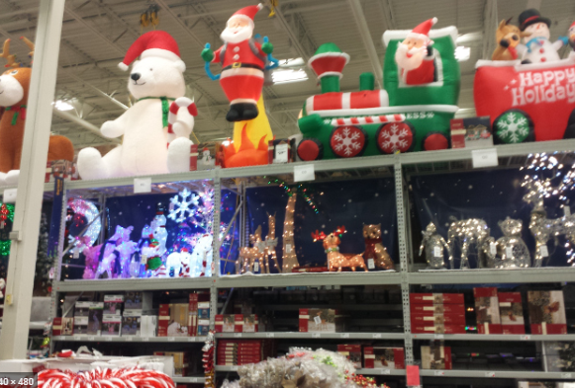
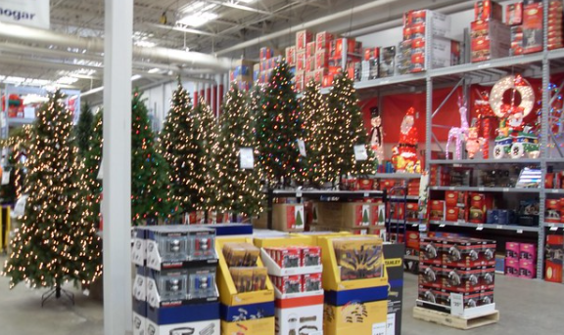
Major retailor

Slide 34
John 10:10
Steal –
Kill –
Destroy –
steal our finances
the focus of Christ
glory of Christ

Slide 35
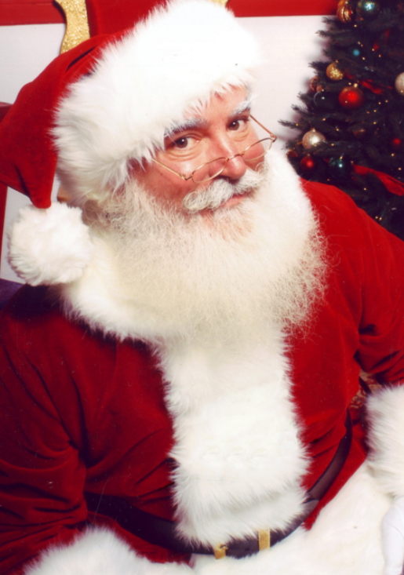
SANTA
If your children are grown… don’t allow this message to condemn you
Take the truth and see how to help others

Slide 36
SANTA
Legend of Santa Claus can be traced back hundreds of years to a mon St. Nicholas (somewhere around 280 AD)
Some say he gave away his inherited wealth and traveled the countryside helping the poor and sick
His original Dutch nickname was Sinter Claus

Slide 37
SANTA
He’s omnipresent
He is everywhere….. Watching you..Judging you…
John 12:48 There is a judge for the one who rejects me and does not accept my words; the very words I have spoken will condemn them at the last day.
Enemy loves to steal the focus/glory from Christ to idols or worship of other gods
Jonah 2:8

Slide 38
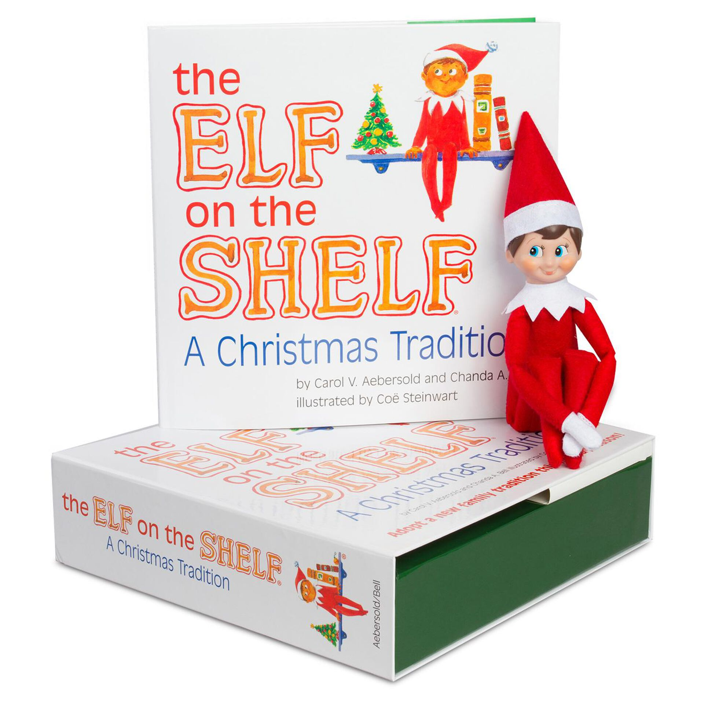
SANTA
IS this lying?
When is the age of a child finding out?
When is the age of accountability?

Slide 39
Christ
Understand this is a sensitive time… what if the person that has been idolized the most during this time is found out to be untrue? Could that impact them from believing in Christ?

Slide 40
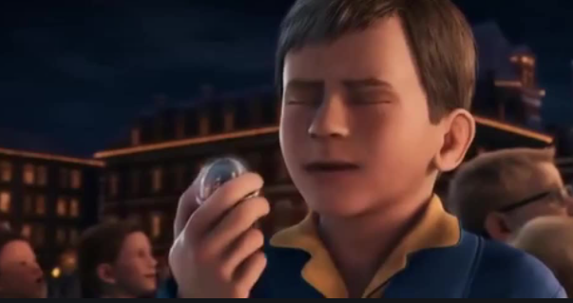

Slide 41
Jesus was actually likely born in SPRING OR FALL

Slide 42
warnings
Jonah 2:8
Colossians 2:8 See to it that no one takes you captive by philosophy and empty deceit, according to human tradition, according to the elemental spirits of the world, and not according to Christ.
Matthew 15:3 Jesus replied, “And why do you break the command of God for the sake of your tradition?
Ephesians 5:11 Have nothing to do with the fruitless deeds of darkness, but rather expose them.

Slide 43
warnings
Titus 3:9-11 But avoid foolish controversies, genealogies, dissensions, and quarrels about the law, for they are unprofitable and worthless. As for a person who stirs up division, after warning him once and then twice, have nothing more to do with him, knowing that such a person is warped and sinful; he is self-condemned.
Matthew 15:9 Their worship is a farce, for they teach man-made ideas as commands from God.
Mark 7:9 And he continued, “You have a fine way of setting aside the commands of God in order to observe^{[c]} your own traditions

Slide 44
What do I do now?
Are you telling me to burn my Christmas tree?
DRAW close to God.. Take what has been shared and seek the Father on this.
Repent – I have been repenting – Acts 3:19
James 4:17 - If anyone, then, knows the good they ought to do and doesn’t do it, it is sin for them.

Slide 45
Why do we take Communion? ROOT behind the FRUIT
Matthew 26:26-28 Now as they were eating, Jesus took bread, and after blessing it broke it and gave it to the disciples, and said, “Take, eat; this is my body.” And he took a cup, and when he had given thanks he gave it to them, saying, “Drink of it, all of you, for this is my blood of the covenant, which is poured out for many for the forgiveness of sins.
Luke 22:19-20 And he took bread, and when he had given thanks, he broke it and gave it to them, saying, “This is my body, which is given for you. Do this in remembrance of me.” And likewise the cup after they had eaten, saying, “This cup that is poured out for you is the new covenant in my blood.

Slide 46
Proverbs 4:26 Give careful thought to the paths for your feet and be steadfast in all your ways.
Haggai 1:7 This is what the Lord Almighty says: “Give careful thought to your ways.
2 Corinthians 13:5 Examine yourselves to see whether you are in the faith; test yourselves. Do you not realize that Christ Jesus is in you--unless, of course, you fail the test?

Slide 47
What is it really about?
Presents – what am I getting
Santa
Décor
Traditions
Jesus?
Make it about Christ (the Word)! Take mass out of Christmas

Slide 48
Describe the day after Christmas
Wew---I am glad that is over
Not many sales were made… not about how many lives were changed
I am sooo sad it is over
Is this leading us down a path that is not God?

Slide 49
Are you going to celebrate it?
Are you going to celebrate it as the world
What does that look like if I am going to celebrate it?
Guidelines
Gift giving (in your home and others)
Make sure it is inline with God’s Word
Avoid commercialization.......
Santa and other noise – eliminate- Christmas tree??
Be set free of traditions of man
Romans 14:5-12
Ever stayed in your car while your birthday party went on inside?

